Slide 1
TECH MARVELS
Nilesh .B. Rajput
Tulashi .G. Sabat
Ragini .J. Singh

Slide 2
PROBLEM STATEMENT
To face challenges by students in finding personalized academic and career guidance due to existing platforms lacking integration. Without individualized advice, students can feel overwhelmed by available information, complicating course and career choices. This highlights the need for a solution offering targeted mentorship, tailored course recommendations, and AI-driven career pathways aligned with individual goals and interests.

Slide 3
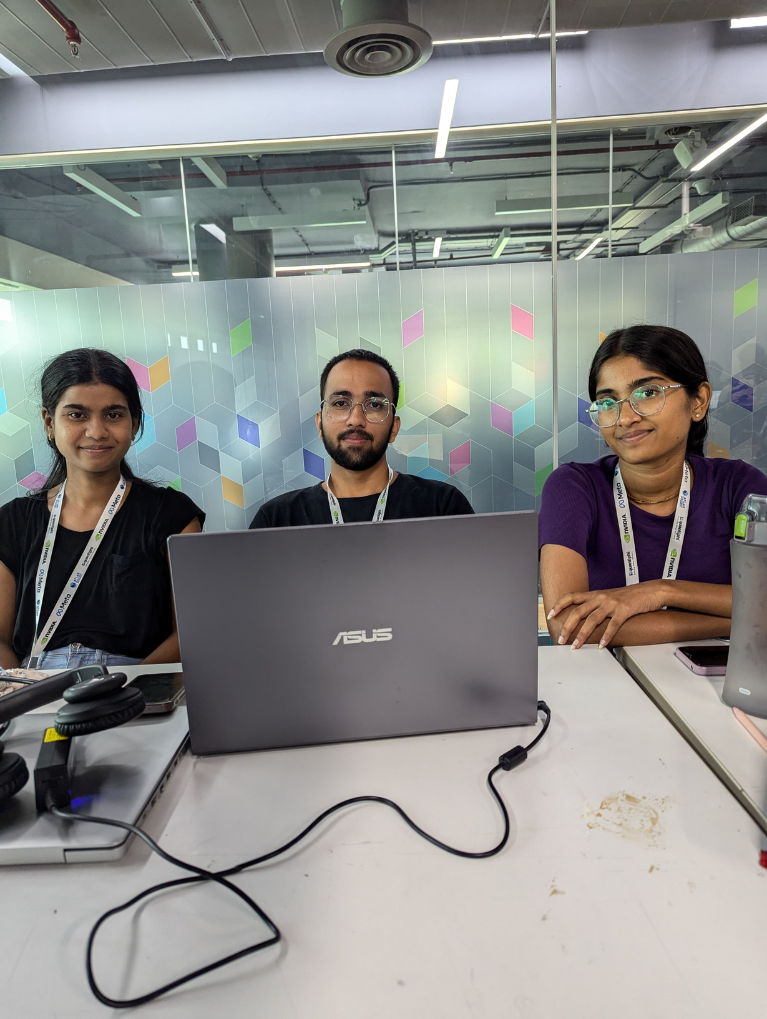

Slide 4
Describe your solution
The app is a React-based platform where students can connect with mentors, receive tailored course recommendations, and use an AI-powered career pathway generator. Students find mentors suited to their needs, get course suggestions based on their interests, and follow a personalized career roadmap created by AI to achieve their goals. This all-in-one approach simplifies decision-making, providing students with clear guidance for academic and career growth.

Slide 5
Thank you

